Slide 1
AGYEMAN OBED YAW
Web Tech Fall 2021 Final Exams

Slide 2
Obed Agyeman is developing a data powered website to help kuntumkum Mortuary solve deaceased body management issues

Slide 3

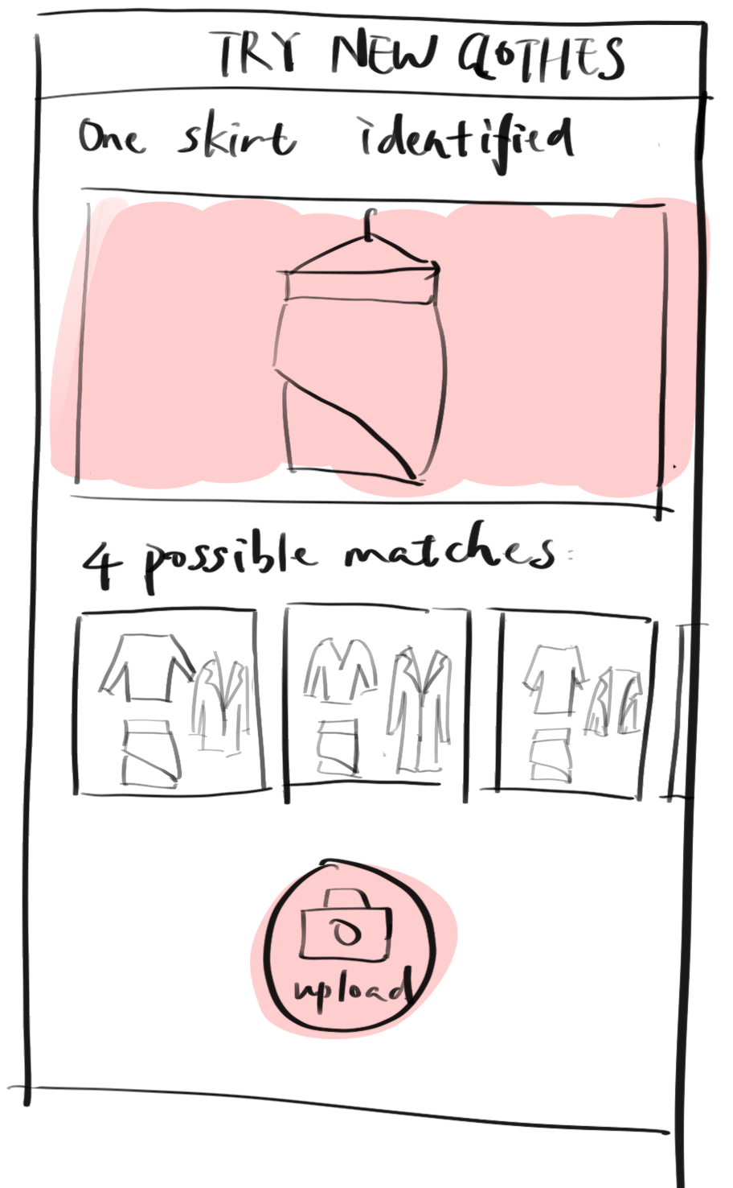
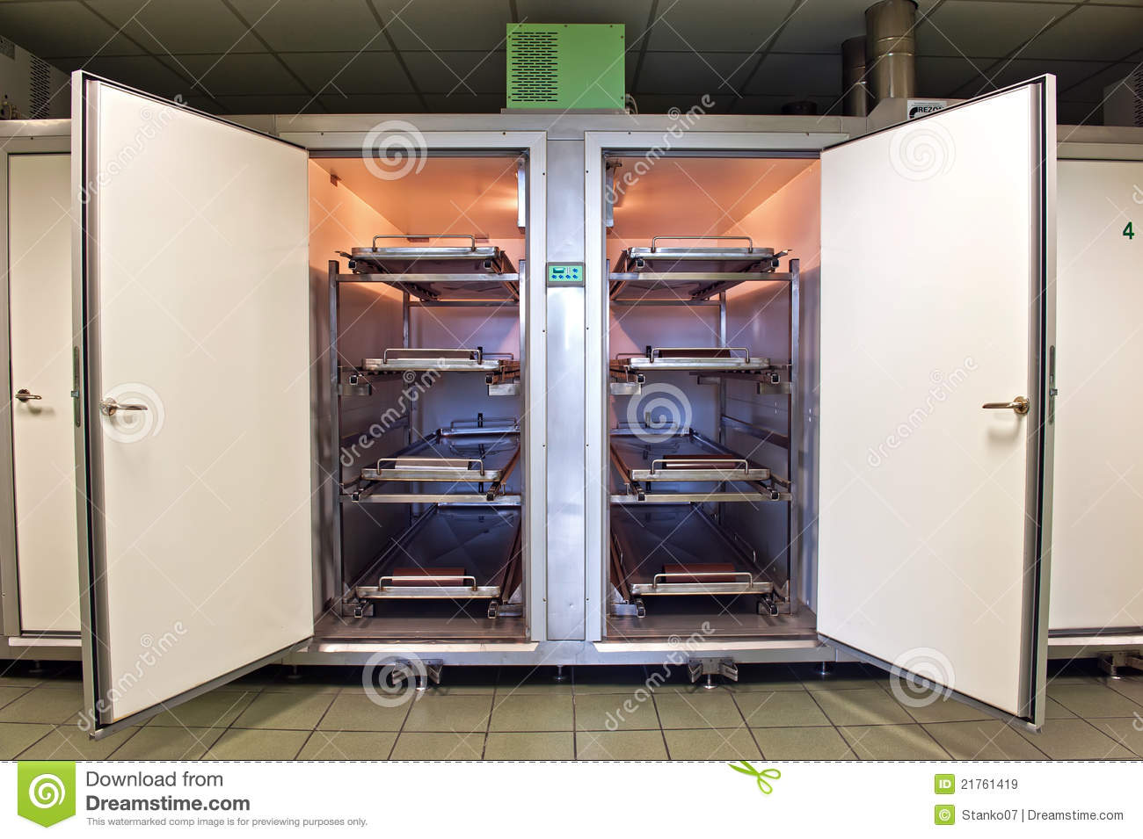

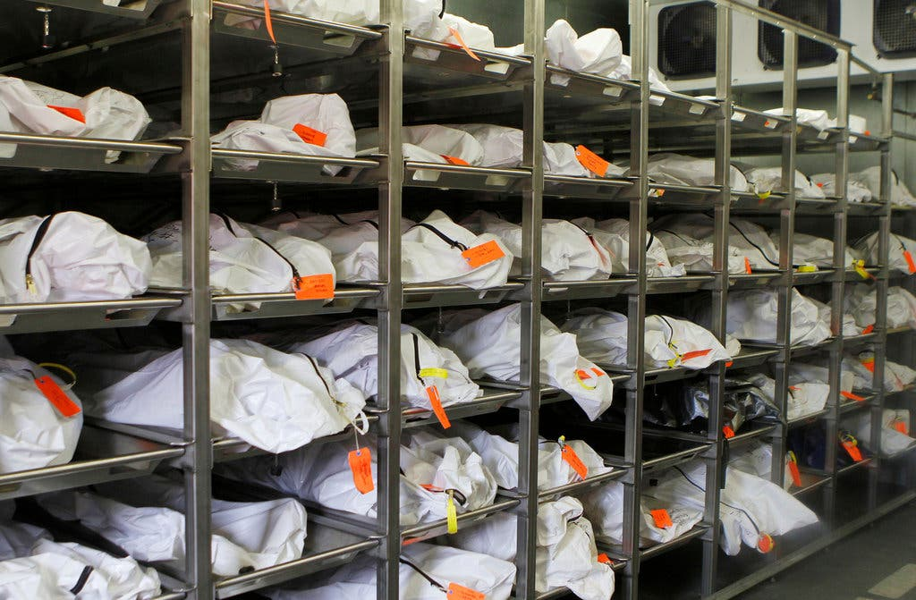
The kuntumkum mortuary website
ddd
The database enables mortuaries to keep efficient and accurate data on human corpses awaiting
identification or removal for autopsy or respectful burial, cremation or other methods.
PAYOFF: What is a simple drawn screen that is illustrative of something the website shows that helps solve the problem. It is likely a report or some results of data entered by the participants. This is the most important square
This website will be used by the mortuary staff to register deceased bodies and assign them rooms and beg and tag number to the deceased.
The database allows mortuaries to store up-to-date information about human bodies awaiting identification or removal for autopsy, respectful burial, cremation, or other ways.

Slide 4
User / Customer
Morgues and hospitals will use the website to keep track of the bodies they receive. Also, they can readily retrieve their corpses without having to look for them.
. Dieners will use the website. Dieners are mortuary employees that are in charge of handling, transferring, and cleaning the deceased.

Slide 5
Main Functions of the Website
Register incoming deceased body.
Assign room and bed and tag number to the deceased body.
Capture relatives’ details of incoming deceased.
Generate invoices to relatives of deceased.

Slide 6
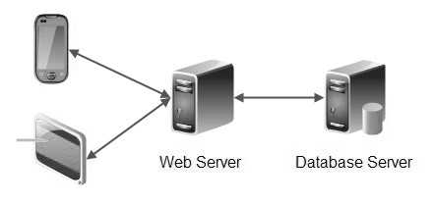
Architecture
Presentation tier: which is built with HTML5, cascading style sheets (CSS) and JavaScript, is deployed to a computing device through a web browser or a web-based application.
Application Server: The application tier, which may also be referred to as the logic tier, is written in a programming language such as Java and contains the business logic that supports the application's core functions. PHP was used at this side.
Database Server: The data tier consists of a database and a program for managing read and write access to a database. This tier may also be referred to as the storage tier and can be hosted on-premises or in the cloud.
Client Side
Application Server

